Slide 1
EVALUATION MEASURES
CLASSIFICATION

Slide 2
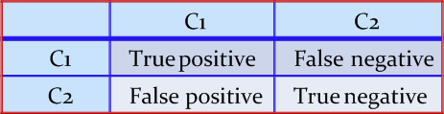
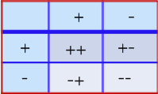
Confusion Matrix
A confusion matrix for a two classes (+, -) is shown below.
There are four quadrants in the confusion matrix, which are symbolized as below.
True Positive (TP: f₊₊) : The number of instances that were positive (+) and correctly classified as positive (+).
False Negative (FN: f₊₋): The number of instances that were positive (+) and incorrectly classified as negative (-).
False Positive (FP: f₋₊): The number of instances that were negative (-) and incorrectly classified as (+).
True Negative (TN: f--): The number of instances that were negative (-) and correctly classified as (-).

Slide 3
Confusion Matrix
Note:
N_{p} = TP (f₊₊) + FN (f₊₋)
= is the total number of positive instances.
N_{n} = FP(f₋₊) + Tn(f₋₋)
= is the total number of negative instances.
N = N_{p} + N_{n}
= is the total number of instances.
(TP + TN) denotes the number of correct classification
(FP + FN) denotes the number of errors in classification.
For a perfect classifier, FP = FN = 0

Slide 4
Confusion Matrix Example
For example,
Calculate the performance evaluation metrics
Class | + | -
+ | 52 (TP) | 18 (FN)
- | 21 (FP) | 123 (TN)

Slide 5

Accuracy
It is defined as the fraction of the number of examples that are correctly classified by the classifier to the total number of instances.
Accuracy$=\frac{TP+TN}{TP+FP+FN+TN}$

Slide 6
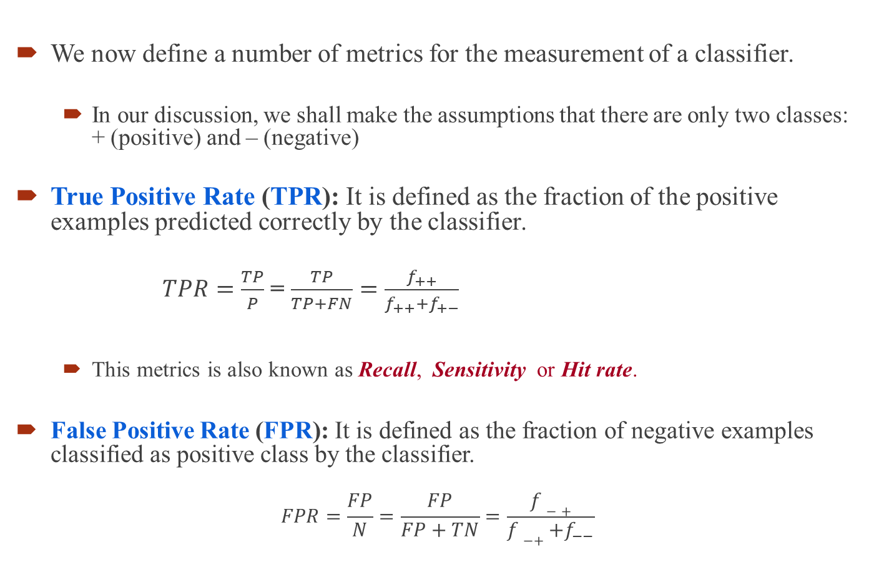
Performance Evaluation Metrics
We now define a number of metrics for the measurement of a classifier.
In our discussion, we shall make the assumptions that there are only two classes: + (positive) and – (negative)
True Positive Rate (TPR): It is defined as the fraction of the positive examples predicted correctly by the classifier.
$TPR=\frac{TP}{P}$ = $\frac{TP}{TP+FN}=\frac{f_{++}}{f_{++}+f_{+−}}$
This metrics is also known as Recall, Sensitivity or Hit rate.
False Positive Rate (FPR): It is defined as the fraction of negative examples classified as positive class by the classifier.
$$FPR=\frac{FP}{N}=\frac{FP}{FP+TN}=\frac{f−+}{f−++f_{−−}}$$

Slide 7
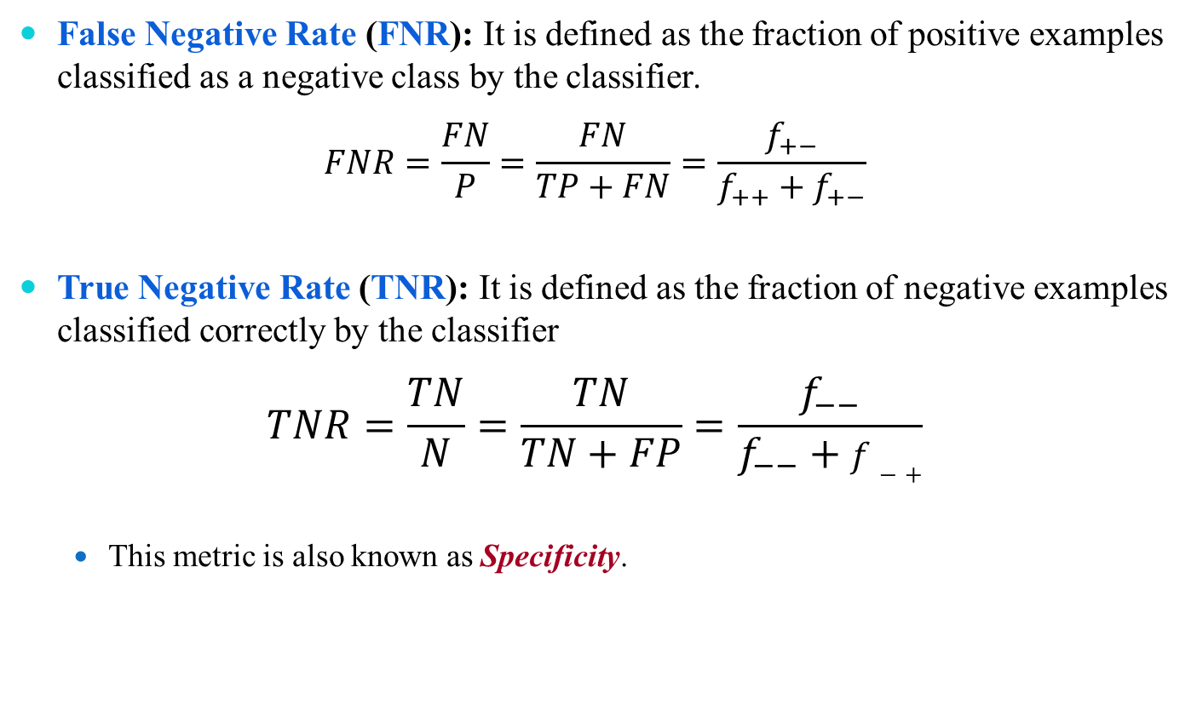
Performance Evaluation Metrics
False Negative Rate (FNR): It is defined as the fraction of positive examples classified as a negative class by the classifier.
$$FNR=\frac{FN}{P}=\frac{FN}{TP+FN}=\frac{f_{+−}}{f_{++}+f_{+−}}$$
True Negative Rate (TNR): It is defined as the fraction of negative examples classified correctly by the classifier
$$TNR=\frac{TN}{N}=\frac{TN}{TN+FP}=\frac{f_{−−}}{f_{−−}+f−+}$$
This metric is also known as Specificity.

Slide 8
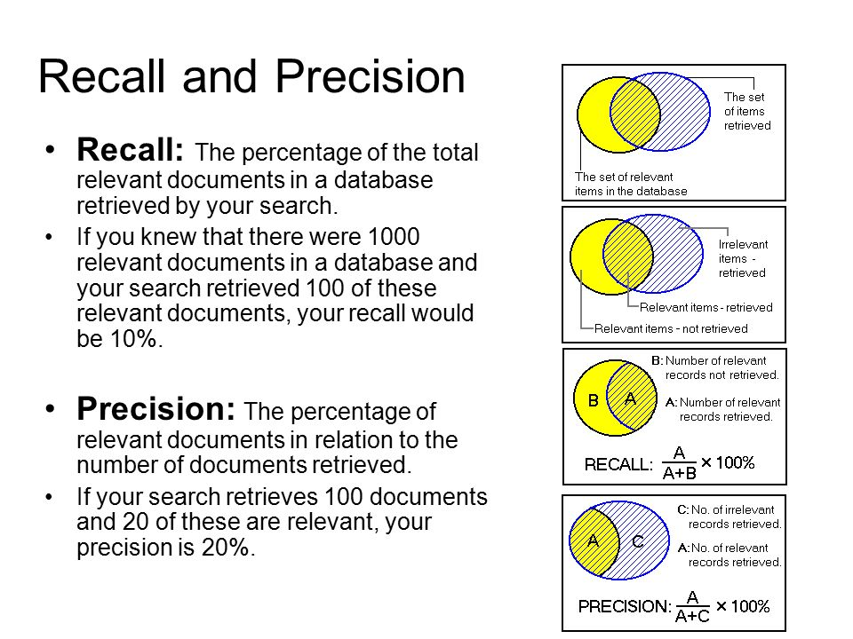

Performance Evaluation Metrics
Both, Precision and Recall are defined by
$Precision=\frac{TP}{TP+FP}$
$Recall=\frac{TP}{TP+FN}$

Slide 9
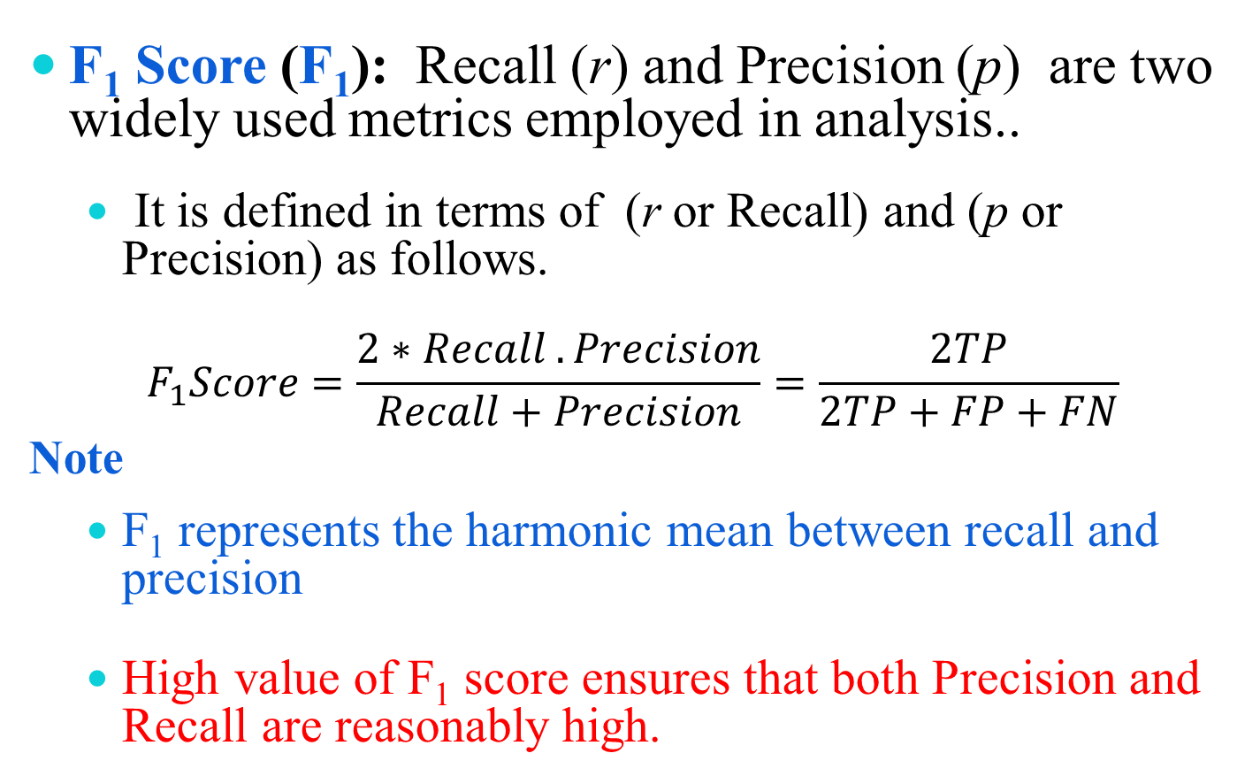
Performance Evaluation Metrics
F₁ Score (F₁): Recall (r) and Precision (p) are two widely used metrics employed in analysis..
It is defined in terms of (r or Recall) and (p or Precision) as follows.
$$F_{1}Score=\frac{2∗Recall .Precision}{Recall+Precision}=\frac{2TP}{2TP+FP+FN}$$
Note
F₁ represents the harmonic mean between recall and precision
High value of F₁ score ensures that both Precision and Recall are reasonably high.

Slide 10
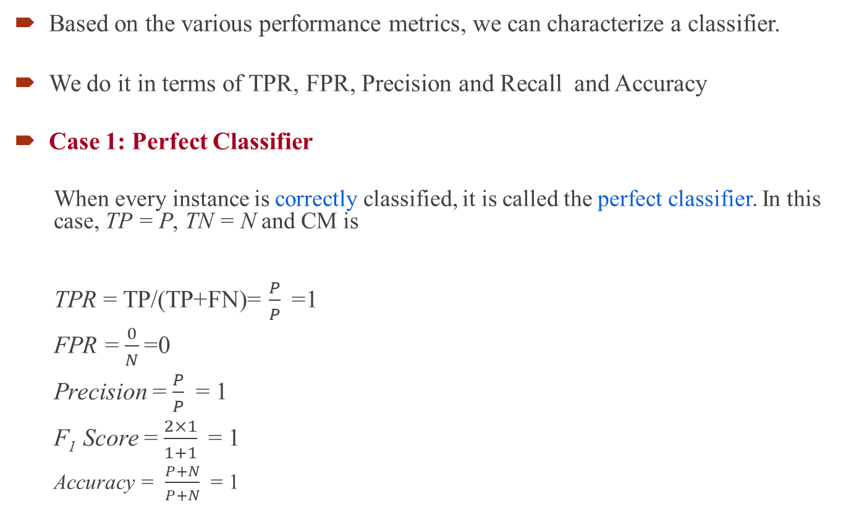
Analysis with Performance Measurement Metrics
Based on the various performance metrics, we can characterize a classifier.
We do it in terms of TPR, FPR, Precision and Recall and Accuracy
Case 1: Perfect Classifier
When every instance is correctly classified, it is called the perfect classifier. In this case, TP = P, TN = N and CM is
TPR = TP/(TP+FN)= $\frac{P}{P}$=1
FPR = $\frac{0}{N}$=0
Precision = $\frac{P}{P}$ = 1
F₁ Score = $\frac{2×1}{1+1}$= 1
Accuracy = $\frac{P+N}{P+N}$ = 1
 |  | Predicted Class
 |  | + | -
Actual class | + | P | 0
 | - | 0 | N

Slide 11
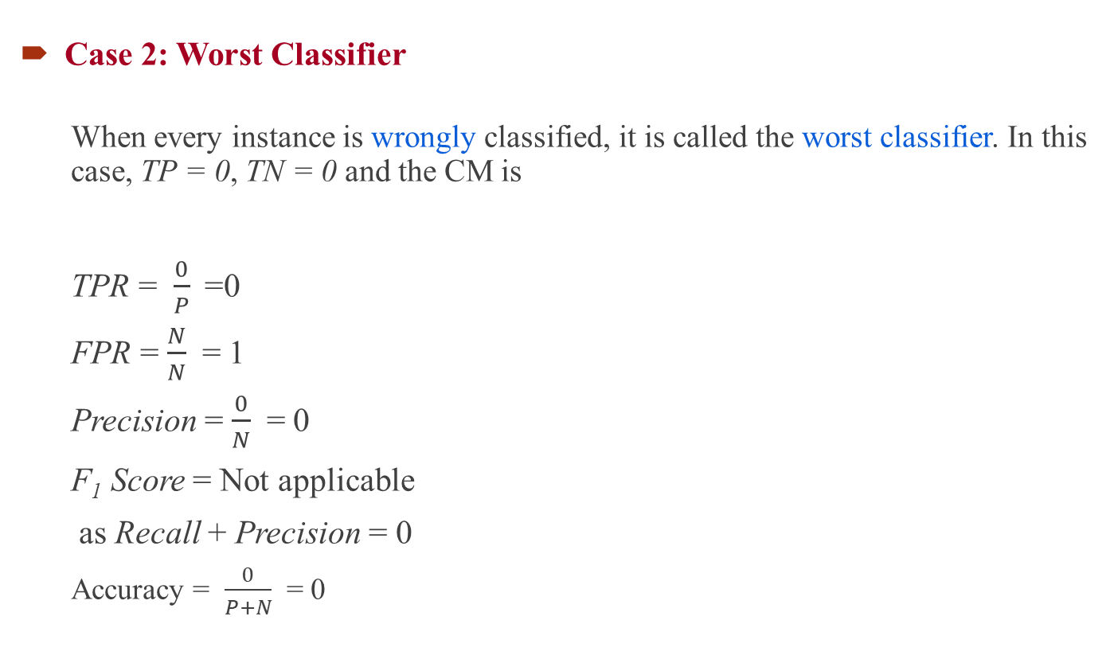
Analysis with Performance Measurement Metrics
Case 2: Worst Classifier
When every instance is wrongly classified, it is called the worst classifier. In this case, TP = 0, TN = 0 and the CM is
TPR = $\frac{0}{P}$=0
FPR = $\frac{N}{N}$ = 1
Precision = $\frac{0}{N}$ = 0
F₁ Score = Not applicable
as Recall + Precision = 0
Accuracy = $\frac{0}{P+N}$ = 0
 |  | Predicted Class
 |  | + | -
Actual class | + | 0 | P
 | - | N | 0

Slide 12

Analysis with Performance Measurement Metrics
Case 3: Ultra-Liberal Classifier
The classifier always predicts the + class correctly. Here, the False Negative (FN) and True Negative (TN) are zero. The CM is
TPR = $\frac{P}{P}$= 1
FPR = $\frac{N}{N}$ = 1
Precision = $\frac{P}{P+N}$
F₁ Score = $\frac{2P}{2P+N}$
Accuracy = $\frac{P}{P+N}$ = 0
 |  | Predicted Class
 |  | + | -
Actual class | + | P | 0
 | - | N | 0

Slide 13
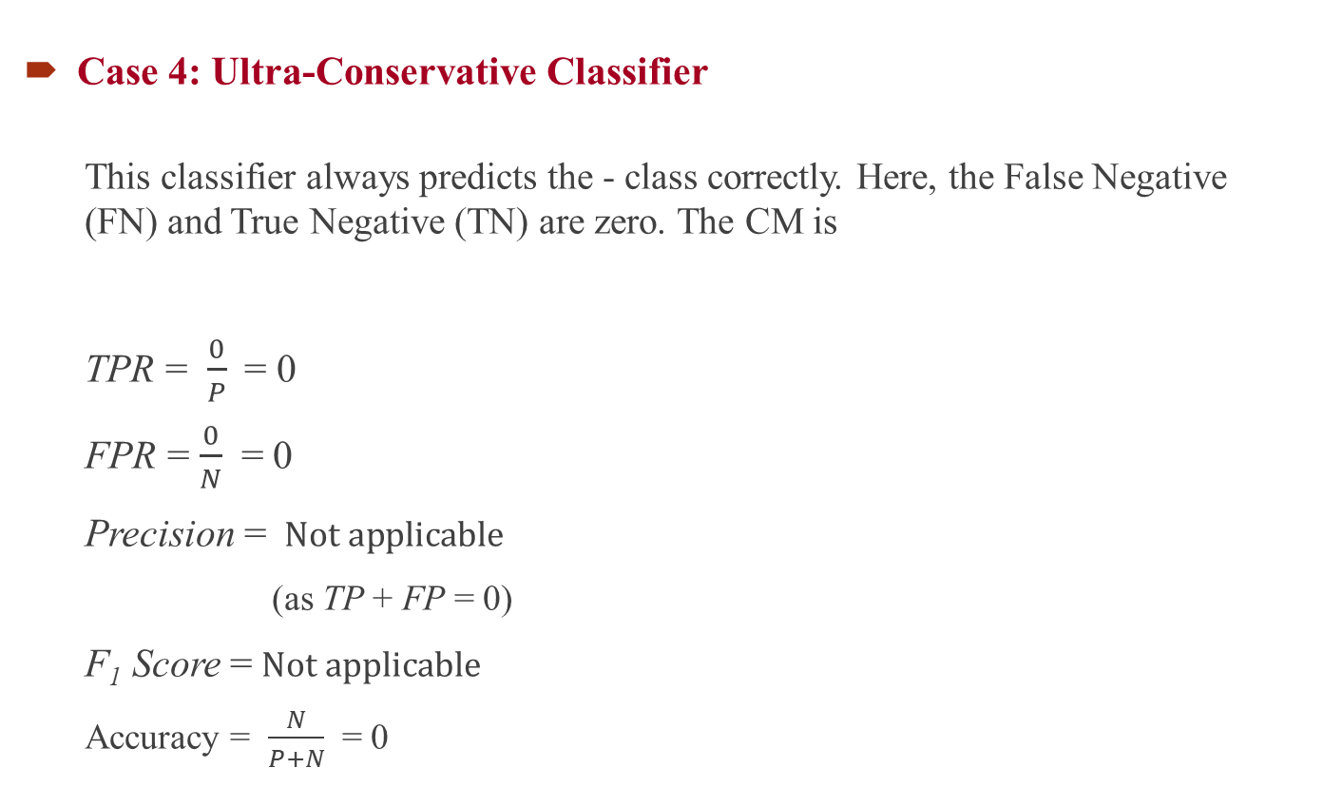
Analysis with Performance Measurement Metrics
Case 4: Ultra-Conservative Classifier
This classifier always predicts the - class correctly. Here, the False Negative (FN) and True Negative (TN) are zero. The CM is
TPR = $\frac{0}{P}$= 0
FPR = $\frac{0}{N}$ = 0
Precision = $Not applicable$
(as TP + FP = 0)
F₁ Score =$Not applicable$
Accuracy = $\frac{N}{P+N}$ = 0
 |  | Predicted Class
 |  | + | -
Actual class | + | 0 | p
 | - | 0 | N

